Slide 1
Developing Integration Solutions using Microsoft BizTalk Server 2013
Business Rules

Slide 2

Course Outline
Module 1: Introduction to BizTalk Server
Module 2: Schemas
Module 3: Maps
Module 4: Testing and Deploying BizTalk projects
Module 5: Pipelines
Module 6: Routing
Module 7: Adapters
Module 8: Web Services and WCF
Module 9: Introduction to Orchestrations
Module 10: Applied Orchestration Techniques
Module 11: Business Activity Monitoring
Module 12: Business Rules
Lesson 1: Working with Business Rules
Lesson 2: Integrating Business Rules
Module 13: Deploying and Managing Applications
Module 14: Windows Azure BizTalk Services

Slide 3
Lesson 1: Working with Business Rules
Where do Business Rules fit in the BizTalk architecture?
Why, when, who and how to use Business Rules?
What are Facts and Vocabularies, Rules and Policies?
Defining and Testing Business Rules
Demonstration: Define and Test a Business Rule

Slide 4








Business Rules in BizTalk Architecture
Host
Business Rules
Host
Receive Port
Business Rules
Send Port
Receive Location
Adapter
Adapter
Host
Orchestration
Pipeline
Pipeline
Map
Map
Message Box
Messages
Subscriptions

Slide 5
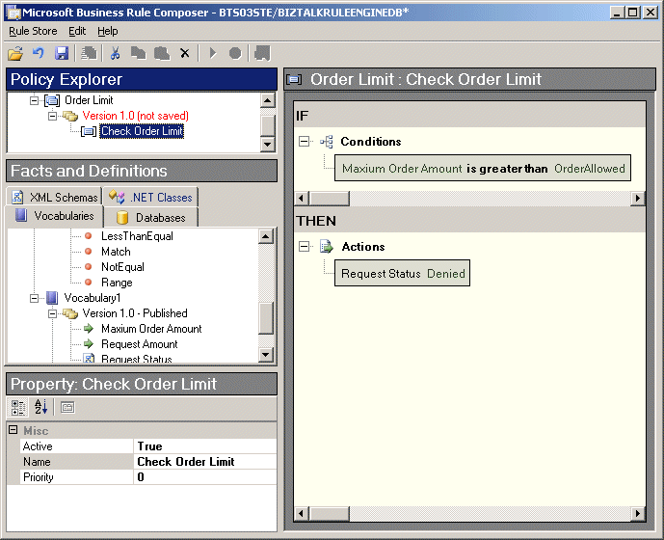
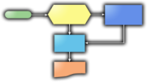
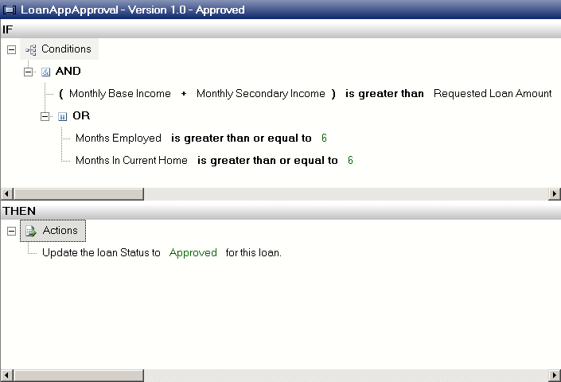



BizTalk Business Rule Engine Architecture
Business Rules Composer
Orchestration
Call Policy
Business Rules Framework
Author
In-memory cache
Invalidate
Business Rule Update Service
Rule Store

Slide 6
When and Why
When?
Business Process and rules change rapidly
Rules are complex and hard to implement
Re-deploying an orchestration is too expensive
You would like to prepare for change
Why?
Separation of concerns
Isolate rules from procedural implementation and coding
Facilitate re-use
Allow for different roles and skillsets to work together
Allow for different change cycles
Lower cost of change
Improve performance of rule processing

Slide 7
How
1
2
3
Plan how to incorporate rules
Analyze business logic
Identify data sources (and create vocabularies)
4
Define rules and compose policy
5
Test and debug policys
6
Publish and Deploy policy
7
Use Business Rules from your orchestration
8
Monitor and track execution

Slide 8






Who and How
1
2
Identify Business Logic & Data Sources
3
7
Developer
Business Analyst
Use policy in orchestration
4
Define Vocabularies and Rules
8
Deploy & Publish
Rule Store
Design and Test Policies
5
6
Information worker
Administrator

Slide 9
Facts and Vocabularies
Facts are a unit of information about something.
It can consist of a:
.NET Object (methods, properties, fields)
XML Document (elements, attrbutes)
Database rowset
Facts can be:
Short term – exists only in a single execution cycle
Long term – are loaded into the memory of the Rule Engine
Vocabularies are:
Versioned and immutable
Optional Domain Specific Language replacements for facts
”Credit value” Xpath: /Order/Customer/Evaluations/Credit/Weight

Slide 10
Rules
If (
(monthlyBaseIncome + monthlySecondaryIncome > loan.Amount)
&& (monthsEmployed >= 6 || monthsIncurrentHome >= 6)
)
loan.Status = Approved;

Slide 11
Rules
A rule is made up of conditions and actions
IF condition(s) THEN action(s)
If the conditions evaluate to true, the actions are executed
Rule
Condition Set
Action Set
Logical Operator
Function
Condition
Vocabulary 1..n
(Data Fact)
Predicate
(boolean operation)
Vocabulary 1..n
(Data Fact)
Function

Slide 12
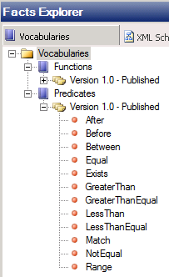
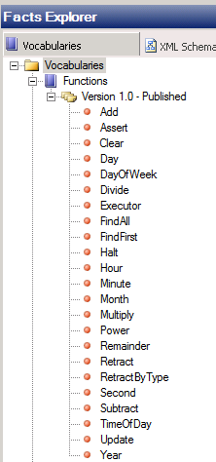
Predicates and Functions
Predicates
Functions

Slide 13

Policy
A Policy is a versioned set of one or more rules
Within a Policy Rules by default execute in arbitrary order
A published policy is immutable
Policy (Rule Set)
Hint!
Rule 1..
Rule n...
Set Rule Priority to control execution order

Slide 14
Business Rule Composer
Rule Composer
Policies
Rules
Fact sources
Vocabularies
Definitions

Slide 15
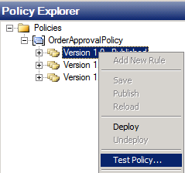
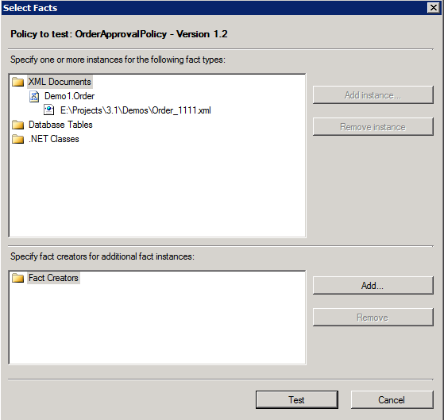
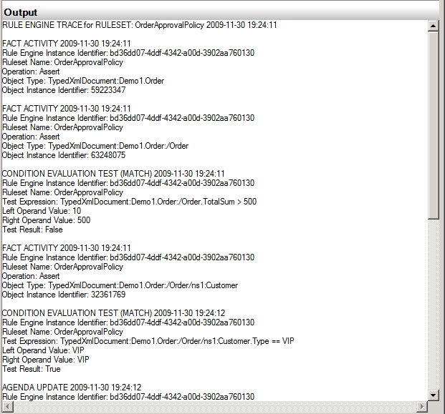
Testing a Business Rule
1
2
3
Create Policy
Select Fact instances
Review output trace

Slide 16

Demo
Working with Business Rules
Define a Business Rule
Test a Business Rule
Notes:
(Slide 16)
Remember to change document type to fully qualified name... Ie ProjectName.SchemaName – Mod11.Order
Regel TotalSum > 1000
Set Approved = true
Visa Vocabularies, använd dem inte

Slide 17
Lesson 2: Integrating Business Rules
Using Business Rules from Orchestrations
Demonstration: Integrating Business Rules
Managing Business Rules

Slide 18


Common Orchestration scenarios for Business Rules
Routing
Decision making
Process engine (step based execution)
Rule based delay
Configuration storage

Slide 19
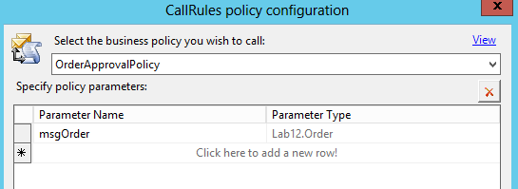


Calling Business Rules from Orchestrations
1
Identify and implement Policy
2
Add a Call Rule shape to Orchestration
3
Set message variables
4
Act upon result

Slide 20
Demo
Integrating Business Rules
Using Business Rules in Orchestrations
Managing Business Rules
Notes:
Do NOT remove this Demo.
We will use it in Mod13 – BAM, where we will monitor it.

Slide 21
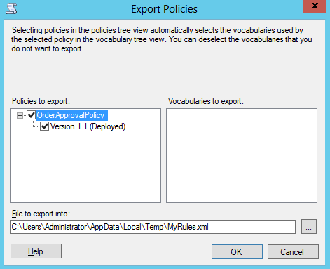
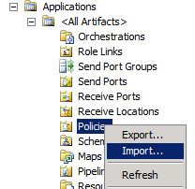
Deploying Business Rules
Export
Import

Slide 22
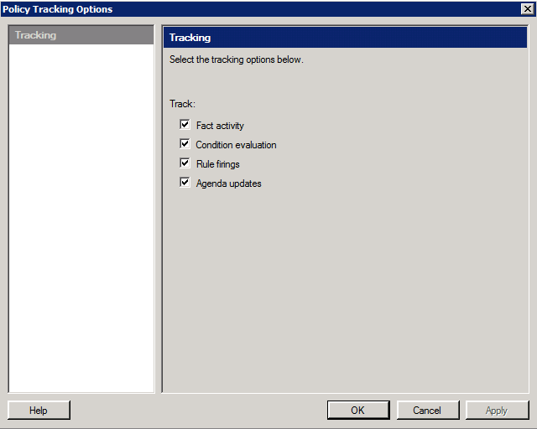
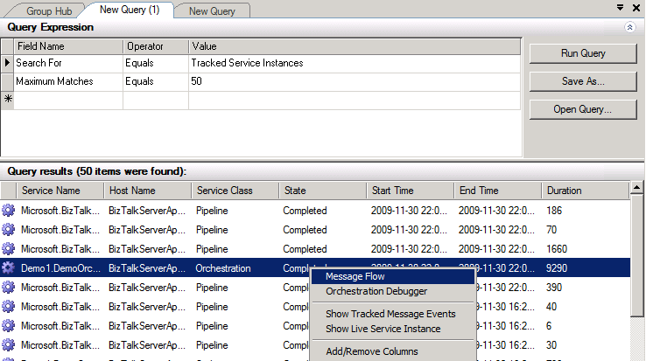
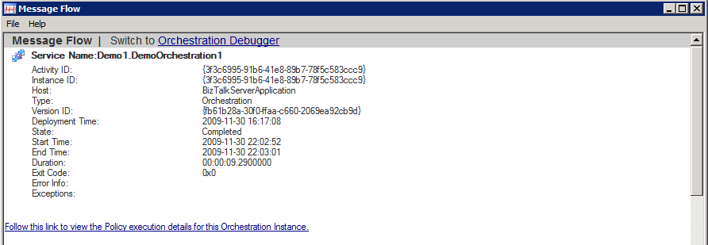
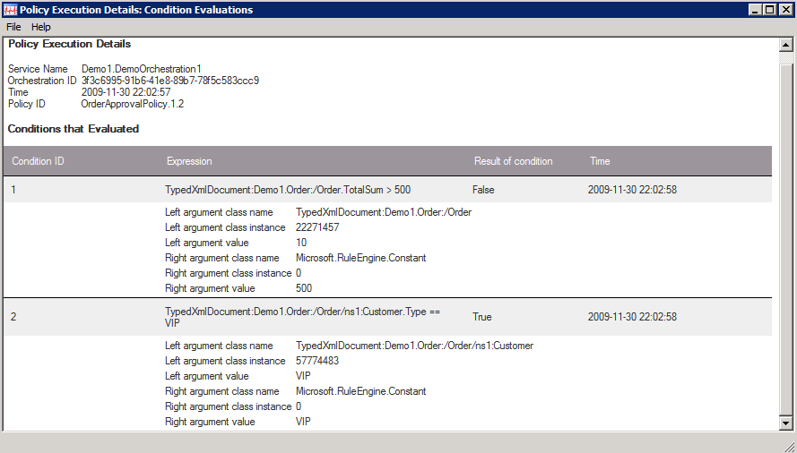
Tracking Business Rules
1
2
3
Select Policy
Configure Tracking
View Tracked Service Instances
4
View Orchestration Messageflow
5
View Policy Execution details
6
View data, for example Fired Rules

Slide 23
Summary
Use Business Rules for implementation of dynamic rules and logic in BizTalk Server to lower the cost of change.
Business Rules are built using Facts, Vocabularies, Rules and Policies.

Slide 24
Q & A
Business Rules

Slide 25


Hands-On-Labs
Integrating Business Rules
Define business rules
Deploy and test business rules
Call rules from within orchestrations

Slide 26

Quiz
What are vocabularies?
What are rules?
What are policies?
Why would you use business rules instead of using shapes to implement business logic within an orchestration?

